Slide 1
Exam Stress
mental health team

Slide 2
How’re you?
Notes:
Get students to reflect by themselves and do a mini check in of how they are feeling today – this self awareness of our emotions and how they can go up and down throughout the day is important when looking into our mental health. Especially around times of exam stress.

Slide 3
Exam stress
Exam stress can become overwhelming for some students and have an impact on their mental health
It is normal to feel worried or nervous about exams
Some students may experience anxiety or low mood from exam stress and may affect their sleeping or eating habits
If you recognise any of these feelings or are worried that exam pressure is taking over your life, you are not alone, and there are things you can do

Slide 4
(Samaritans, 2022)
Notes:
Discuss how people deal with exam stress in different ways and not to compare yourself to someone else who seems like they don’t need to revise or don’t care. Focus on yourself and your habits.

Slide 5
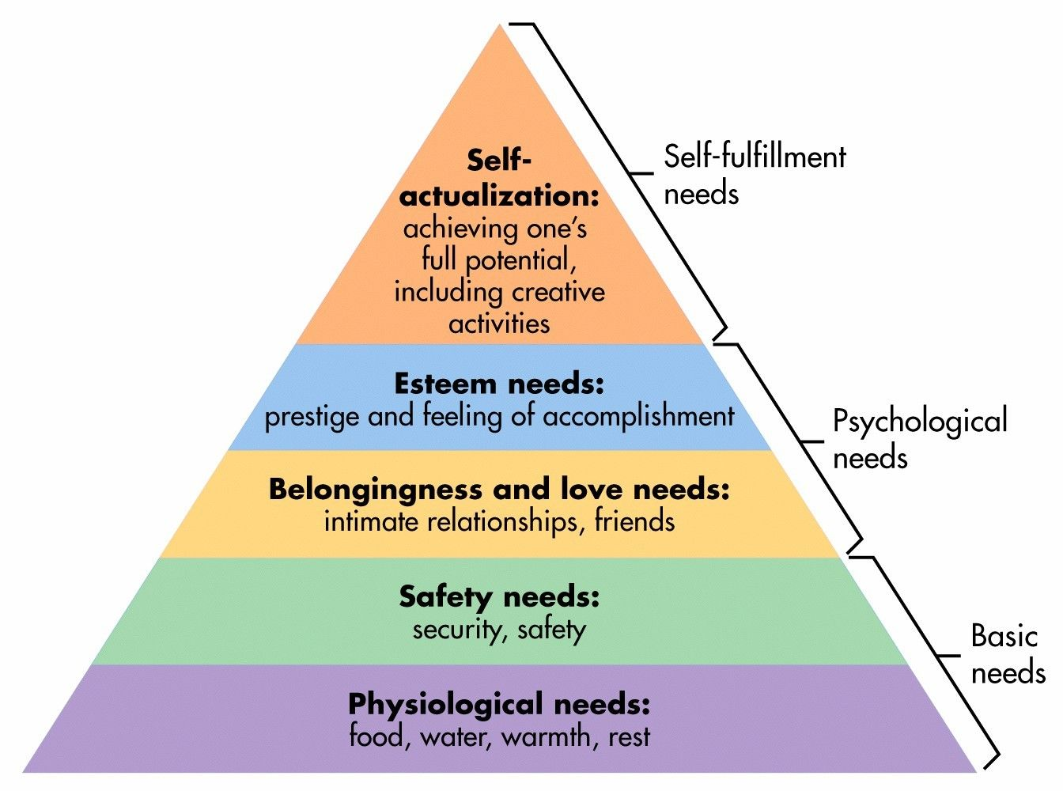
Are you getting enough sleep - 7/8 hours each night?
What is your diet like?
Are you getting enough fresh air and exercise?
Is your environment right to revise?

Slide 6
Notes:
Our human nature is to what to stay in our comfort zone, there is sometimes nothing wrong with this. However we need to learn how we push ourselves out of the comfort zone into a learning zone.

Slide 7
Science-backed revision tips!

Slide 11
Exam Day Tips
1
Give yourself plenty of time in the morning so you are not rushing and have enough time for breakfast
Check what site your exam is in and what room and time you need to be there
3
Before leaving home, check that you have everything that you will need – ID, stationery, etc.
4
Read all the questions carefully before starting and quickly plan how much time to allocate to each.
5
Start answering the questions that you feel most confident about.
6
If your brain freezes, just start writing anything and you will soon start remembering more details.
7
Stay calm, you have done your homework and have nothing to fear!
2

Slide 12
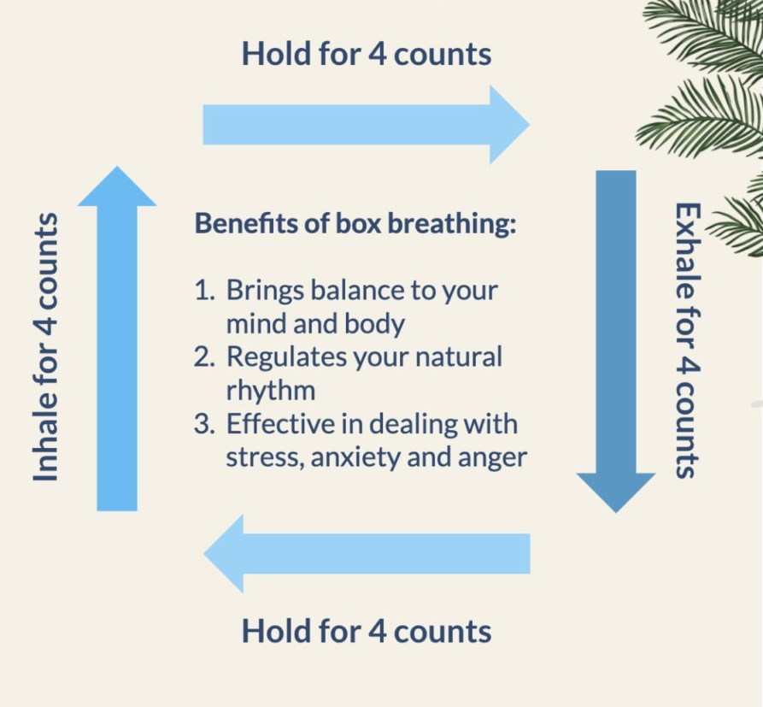
Breathing Exercises

